Slide 1
Manufacturing Technology
08/02/2018 (ME461)
Instructor: Shantanu Bhattacharya

Slide 2
Computer control of manufacturing systems
Use of computers in various manufacturing systems has lead to an overall increase in productivity and efficiency.
It started with one of the earliest applications to numerically control independent manufacturing unit from which the recent PLC based applications at the manufacturing system level emerged.
Numerical control (NC) is a term used to describe the control of the various functions of a machine by the use of numeric data. The term was coined at MIT, where the first successful NC machine was demonstrated under a subcontract from the Parsons Corporation of Traverse city.
Numerical control is now applied to a wide range of machines including welding, riveting, bending, hole making and drafting machines.
However, the vast majority of NC machines in use today are metal cutting machine tools.

Slide 3
Metal Cutting Machines
The metal cutting operation (also called machining) is one of the most important manufacturing processes in industry today.
In addition to being a primary manufacturing process, it is used as a finishing operation after other processes such as casting and forging because of its ability to achieve very high dimensional accuracy and close surface finish.
The nature of the metal cutting process involves removal of excess material from a raw work-piece using a cutting tool, thus changing the shape of the work-piece.
By controlling how the excess material is removed, we can control what the final shape of the work-piece would be.
Material removal is achieved by forcing a sharp cutting edge (cutting tool) into the work-piece and then to force relative motion between the tool and the work-piece.

Slide 4
Metal cutting machines
Of course metals are hard and therefore high forces are required, first to feed the tool into the work-piece and then to force relative motion between the tool and the work-piece so as to remove the chips for which high power machines are employed.
Relative motion between the cutting tool and the work-piece can be achieved by keeping the work-piece stationary and moving the tool or by keeping the tool stationary and moving the work-piece.
The main function of a machine tool is to control the work-piece-cutting tool positional relationship in such a way as to achieve a desired geometric shape of the work-piece with sufficient dimensional accuracy.
Actual machine tool movements are made up of one or more degrees of freedom which can be combined to form various geometric shapes such as cylinders or flat surfaces.

Slide 5
Metal cutting machines
In using a machine tool to carry out a machining process, we need to accomplish the following basic machining function:
Determining the location on the work-piece where the machining is to be done.
Controlling the path followed during the motion of the tool or work-piece.
Controlling the rate at which the path is traversed.
Controlling the rate at which the tool is fed into the work-piece.
Notes:
In a conventional machine tool the human operator loads the work-piece onto the machine tool. The accuracy of the machined component depends on the operators skill and experience in process setting and would have a lot of variability.

Slide 6
Numerically Controlled Machine
An NC machine tool is functionally the same as a conventional machine.
The technological capabilities in terms of machining are no different from those of conventional machines.
The difference between NC machines and conventional machines is in the way in which the various machine functions and slide movements are controlled.
With NC machines functions as such as positioning the tool, turning the spindle on and off, setting cutting speeds or feed rates, and turning coolant on and off are removed from the realm of the machine operator and turned over to Machine control unit (MCU).
The MCU issues commands in the form of numeric data to motors controlling the individual machine functions and as such can be used for direction control, controlling rate of slide motion, spindle rotation, tool changes, coolant throw etc.
The first NC machine was a retrofitted system with appropriate motors and control systems and many such generation 1 NC systems were retrofitted conventional machines.

Slide 7
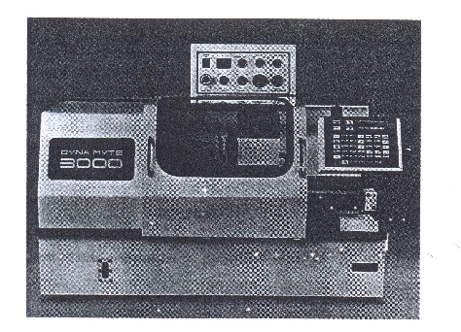
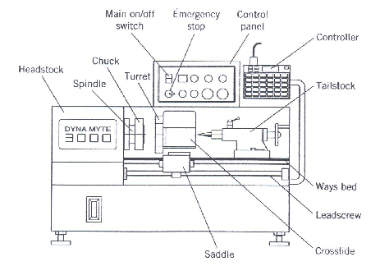
Numerically Controlled Machines
Line drawing of an NC lathe
Picture of an NC lathe

Slide 8
Types of NC control systems
Open Loop Control and Closed Loop Control System
Open Loop Control System: This type of control system is used with a special motor called a stepper motor. In this control, signals in form of current pulses are sent from the MCU to the individual motor being controlled.
Each pulse results in a finite predetermined amount of revolution of the motor. To cause a specified amount of movement, the control system determines how many current pulses are required and sends precisely that number to the motor.
Thus the control does not need to monitor specifically where the motor is located; it is assumed that the required motion is achieved if the correct number of pulses is sent.
The control system needs to only keep track of how many revolutions the motor has gone through, to know the motor’s position.
Notes:
These are much easier to maintain, less costly, less complex and are smaller with smaller NC machines. However, with the type of control system there is no way to correct errors that might occur during the operation because there is no feedback to the controller. Also, as steppers cannot generate a huge amount of torque therefore these systems are not popular with large machines requiring more power.

Slide 9
Close Loop Control
Conventional variable speed DC motors (servos) are used in this type of control system.
DC motors have an important advantage of being able to generate very high levels of torque, and they can in essence, be reversed instantly.
However, they cannot be caused to move in a very precise amounts as stepper motors can.
In order to keep track of the position of the motor a separate position sensor, called resolver, has to be fitted and the position information so determined is fed back as signal to the controller.
Because of this feedback, the system forms a closed loop.
The positional information from the resolver is compared with the target position and any errors are determined. Because DC motors can be reversed instantly, it is possible to correct any positional error detected.
Notes:
Closed loop systems are generally used in larger NC machines because of the higher load. They are also used in machines where greater accuracy is desired, regardless of size. Closed loop control systems are more complex, and expensive to buy and maintain.

Slide 10
Programming of NC machines
For a NC machine to accomplish the required machining operations, the necessary data have to be entered into the MCU.
The MCU can then convert the data into commands that can be issued to the appropriate motors for the necessary functions to be executed.
The series of data that is fed into the MCU to generate the required machine tool commands is referred to as an NC part program.
The process of writing an NC part program is called NC part programming and the person responsible for writing this is a part programmer.
NOTE: A part program refers to the program required to machine a specific part or component; it is not meant to suggest that the program is incomplete!

Slide 11
Programming of NC machines
The NC part programmer needs to have knowledge of a wide range of manufacturing processes and posses skill as a machine operator.
In particular, he or she needs to have a thorough knowledge of the capabilities of the machine for which the program is being written.
This ensures that the program written makes the maximum use of the machine’s capabilities without violating it’s technological constraints.
The current resource availability respecting cutting tools, jigs and fixtures, labor available, or any other material handling equipment such as robots or automated guided vehicles must also be taken into account.

Slide 12
Programming of NC machines
In writing the part program, the programmer generally starts with an engineering drawing of the part to be made.
This must be interpreted to determine the individual operations that should be performed on the work-piece to produce the final component according to the design specifications.
It is the basis used to determine the order in which the operations should be carried out, establish the cutting conditions to be used in each machining operations , determine the associated non machining operations such as tool changing, machine setup, coolant use etc. and select the appropriate jigs and fixtures to be used to hold the workpiece as the machining is being done.

Slide 13
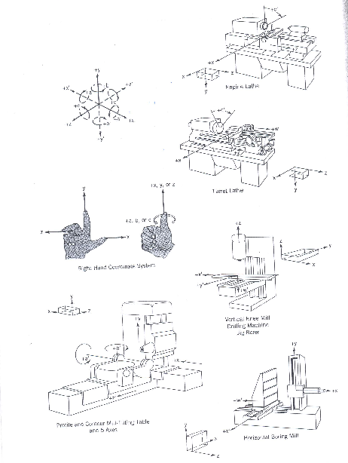
Motion and coordinate system nomenclature
Z-axis: This is the most important axis for machining and it is always aligned with the spindle that imparts cutting power. This spindle might rotate the workpiece as in a lathe, or it might rotate a tool as in a milling machine. If no such spindle exists on a specific machine, the z-axis is perpendicular to the workholding surface. Positive motion in Z tends to increase the separation between the workpiece and the tool.
Notes:
Basic purpose of a part program is to maintain the correct tool-workpiece positional relationship during machining. This is established by defining a coordinate system where the standard really is the right handed coordinate system.

Slide 14
Motion and coordinate system nomenclature
2. X-axis: The x-axis is the principle axis of motion in which the moving element is positioned. It is parallel to the workholding surface and is arranged to be horizontal if possible. On machines with rotating workpieces, it is radial and parallel to the cross-slide. On machines with rotating tools,
If the z axis is horizontal, the positive x- motion is to the right when looking from the spindle to the workpiece.
If the z axis is vertical, the positive x motion is to the right when looking from the spindle to the column.
Notes:
On machines with non rotating workpieces and tools, the x axis is parallel to and directed toward the principle cutting direction.

Slide 15
Motion and coordinate system nomenclature
3.Y-axis: Once the z- and x- axes are established, the y-axis must be in such a direction as to complete a right handed Cartesian coordinate system.
4. Supplementary linear motion:
On some machines, there are secondary linear motions parallel to x,y and z motions. Such supplementary motions are designated U,V and W respectively.
5. Rotary motion:
Motions A,B, and C are rotary motions about the axes respectively parallel to the x,y, and z axes. A positive rotary motion is in a direction that would cause a right handed screw to advance in the positive direction of the axis of rotation.
6. Spindle rotation: Counterclockwise spindle rotation is considered as positive.
Notes:
On machines with non rotating workpieces and tools, the x axis is parallel to and directed toward the principle cutting direction.

